Slide 1
To the teacher: This unit is to get our students more involved in
the election process. It includes:
* a PowerPoint which has pictures and active links to learn more
about selected propositions.
* a pdf of the Ballot which may be reproduced at the school
site on 8 1/2” X 14” paper (two sided). It may be used
independently or with the PowerPoint for discussion.
* a word document of the Ballot if you wish to delete some
propositions or add others to the Ballot.
These propositions were NOT included in this Ballot:
CA Prop. 1 (Abortion), Prop 26 (Gambling), Prop 29 (Kidney dialysis)
City Prop. A (Retiree Supplemental Cost of Living), B (Public Works
Department and Commission), C (Homelessness Oversight Commission),
D (Affordable Housing Now), E (Affordable Housing – Board of Supervisors),
H (City election in even-numbered years), M (Fill Empty Homes),
N (GG Park Parking Garage) Prepared by TACT Curriculum Committee

Slide 2
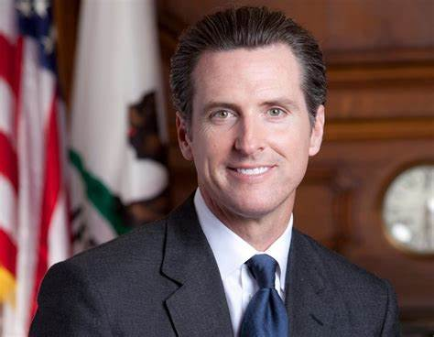
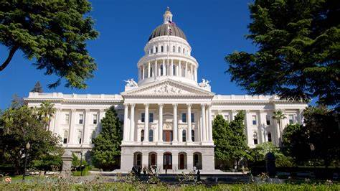
VOTE November 8, 2022 California General Election
Governor: Vote for one
X
l
l
Gavin Newsome
Democrat, Incumbent
(He is governor now.)
Brian Dahle
Republican
(He is a state
senator now.)
The governor works in Sacramento, California.

Slide 3
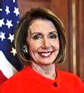
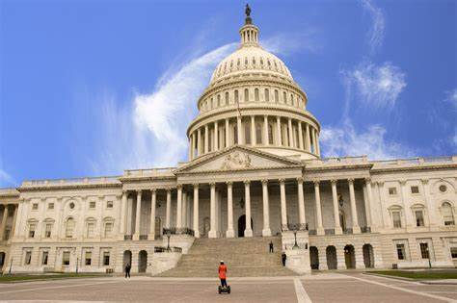
U.S. Representative from San Francisco, California
12th Congressional District - Vote for one:
There are 435 Representatives in the
U.S. House of Representatives, Washington, D.C.]
California has 52 representatives, more than any other state.
l
l
Nancy Pelosi, Democrat
Incumbent - She is the
Speaker of the U.S. House of Representatives.
Shahid Buttar,
Progressive
Independent

Slide 4
Some California State Propositions
For details, see https://easyvoterguide.org/wp-content/uploads/2022/09/EVG-Nov2022-Eng.pdf
easyvoterguide.org includes simple English and translations into Chinese, Spanish, Vietnamese, Korean
Proposition 27: Online Sports Betting
Vote Yes or No
X
l
Yes on 27 Allow betting online on sports for people 21 or older. It's legal in other states. Some of the money would go to helping California's homeless problem.
No on 27 Don't allow online sports betting.
Betters may become addicted or get into debt.
Children might get online to bet. Very little
money would help homeless.
l

Slide 5
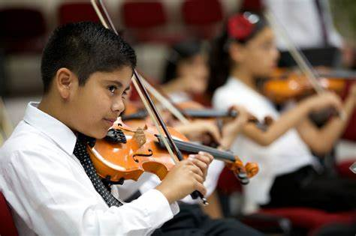
Proposition 28: Art and Music K-12 Education Funding Should the state guarantee more of its budget be for music and arts education in K-12 schools?
Yes on Proposition 28
More of the state's budget should be guaranteed for
music/arts education in K-12 schools.
No on Proposition 28
No more of the state's budget should be guaranteed for
music and arts education
l
l

Slide 6
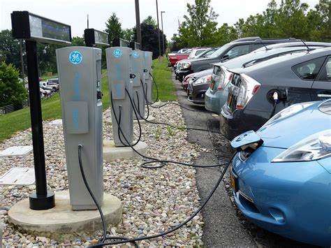
Prop 30: Income Tax on Millionaires for Electric Cars
Yes on Proposition 30
Add an extra tax for people who make over $2 million in a year. Most of the money would be used to increase the use of clean electric vehicles to keep the air cleaner. The rest of this money would be used to manage wildfires. The tax would raise between $3.5 and $5 billion each year.
No on Proposition 30
l
l
Don't tax rich people any more. It's not fair. Rich people might leave California if they have to pay additional taxes.

Slide 7
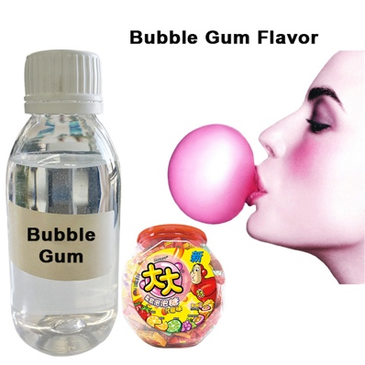
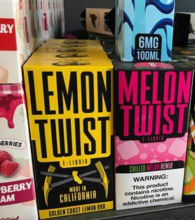
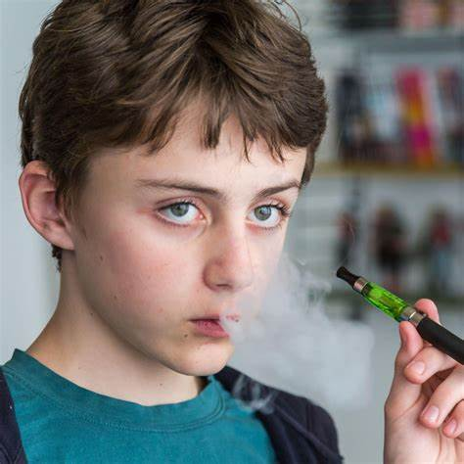
Proposition 31: Banning Flavored Tobacco Products
Examples of flavored tobacco products include candy-flavored e-cigarettes (vaping) or menthol cigarettes.
Yes on 31 Stop the sale of flavored tobacco products at gas stations, grocery stores, vending machines, and other places. Kids are drawn to sweet-flavored tobacco products. Nicotine is very addictive and flavored tobacco could cause life-long addiction. A ban would save lives by keeping children from smoking.
No on 31 Allow for the sale of flavored tobacco products and get the tax money (around $100 million every year).
l
l

Slide 8
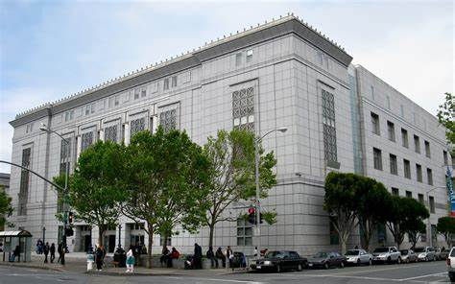
Some S.F. City and County Propositions Vote Yes or No
X
Proposition F: Library Preservation Fund Renewal
which expires in 2023, to be funded by a tax on property.
San Francisco, California, Proposition F, Library Preservation Fund Renewal Amendment (November 2022):
Yes on F
The SF Public Libraries should continue to get funds (after 2023) for increased hours for the main branch and its 27 neighborhood branches being open every week.
No on F
The SF Public Libraries should get no more funds
(after 2023). This will reduce the hours for the
main branch and its 27 neighborhood branches
being open every week.
l
l

Slide 9
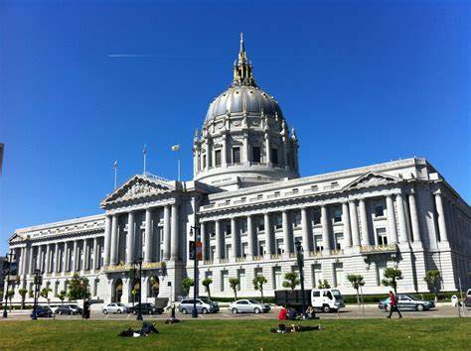
Proposition G: Student Success Grants to Schools
Additional funds for some S.F.U.S.D. schools through 2038.
Because of the COVID-19 pandemic, school shut downs, home learning, teacher shortages, lower enrollment, and large number of students needing support,
SFUSD schools need additional money. The money will come from the City (for example, $11 million for 2023-24, $35 million for 2024-25), coming from a new tax.
• San Francisco, California, Proposition G, Create Student Success Fund to Provide Additional Grants to San Francisco Unified School District Amendment (November 2022):
Yes on G
The City should give grants to some schools
who need help. Schools will apply for grants.
No on G
The City should not give grants to some schools who need help.
l
l

Slide 10
Proposition I: Allow Private Vehicles on JFK Drive except on Sundays and holidays, and on Saturdays from April through September and allow motor vehicles in both directions at all times on the Great Highway. (Because of COVID-19 JFK Drive and other streets were closed to traffic to give people more safe places to get exercise.)
[This is similar to Prop J]
San Francisco, California, Proposition I, Allow Private Vehicles on JFK Drive and Connector Streets in Golden Gate Park Initiative (November 2022):
Yes on I
Allow private vehicles on JFK Drive except from 6 a.m. to 6 p.m. on Sundays and legal holidays as well as on Saturdays from April through September.
Allow vehicles in both directions at all times on the Great Highway.
No on I Keep these roads closed to vehicles every day to use as recreational open space.
l
l

Slide 11
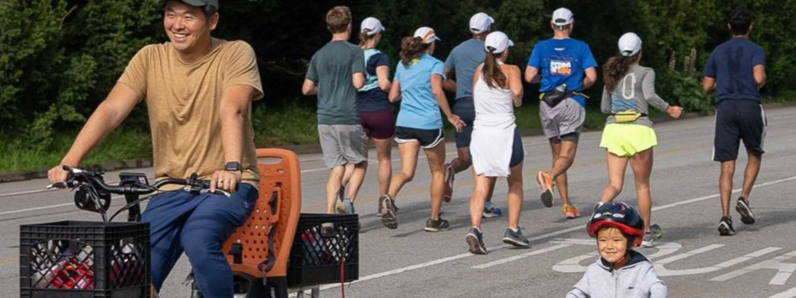
Prop J: In Golden Gate Park, should JFK Drive be closed to traffic and open only for walkers, joggers, and bicycle riders seven days a week? Or should it be open for cars and traffic?
San Francisco, California, Proposition J, Limit Private Vehicles on JFK Drive
l
Yes on J Keep JFK Drive closed to traffic seven days a week.
"It's safer for people. The air is cleaner."
No on J Open up JFK Drive to cars.
"We need to drive into the park."
l

Slide 12
Proposition L:
Continue the 1/2 cent (0.5%) City sales tax through 2053 for transportation projects and allow the Transportation Authority to issue up to $1.91 billion in bonds for transportation projects (safer smoother streets, continue paratransit for seniors and disabled...).
Right now, San Franciscans pay 8.5% sales tax. 0.5% (1/2 ¢) for transportation
A 2/3 (66.67 %) supermajority vote is required for approval of this measure.
San Francisco, California, Proposition L, Sales Tax Renewal for Transportation
Yes on L
Continue the 1/2 ¢ (0.5%) City sales tax for transportation projects;
allow a bond for up to $1.91 billion for transportation projects.
No on L
No more 1/2 ¢ City sales tax. No bond for transportation.
l
l

Slide 13
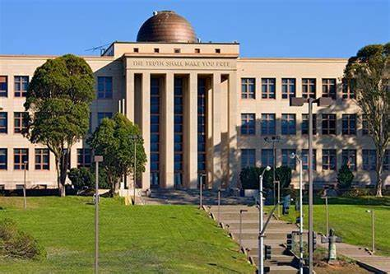
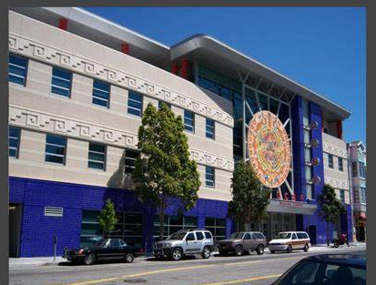
Proposition O: City College Student and Workforce
Development Program
Should there be a new property tax (between $150–$4,000 per parcel) yearly through 2043 to help City College students and workers, including more classes?
San Francisco, California, Proposition O, Additional Parcel Tax to Fund City College Student and Workforce Development Programs Initiative (November 2022):
Yes on O
Yes, a new tax to help CCSF students
and workers and have more classes.
No on O
No new property tax to help CCSF.
l
l

